Slide 1
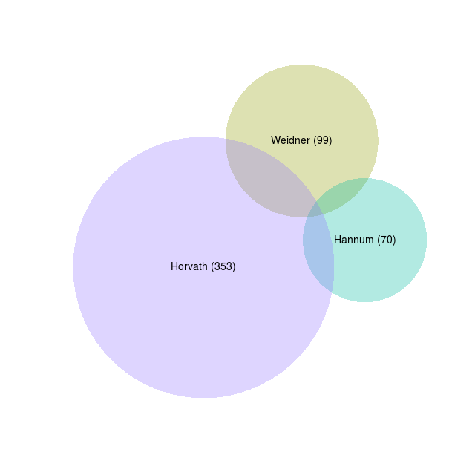
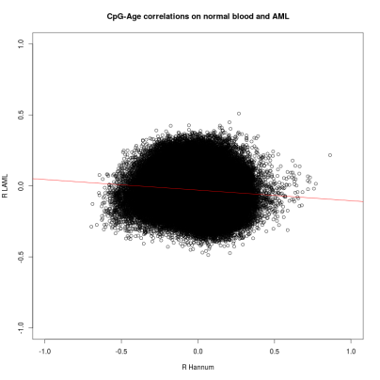
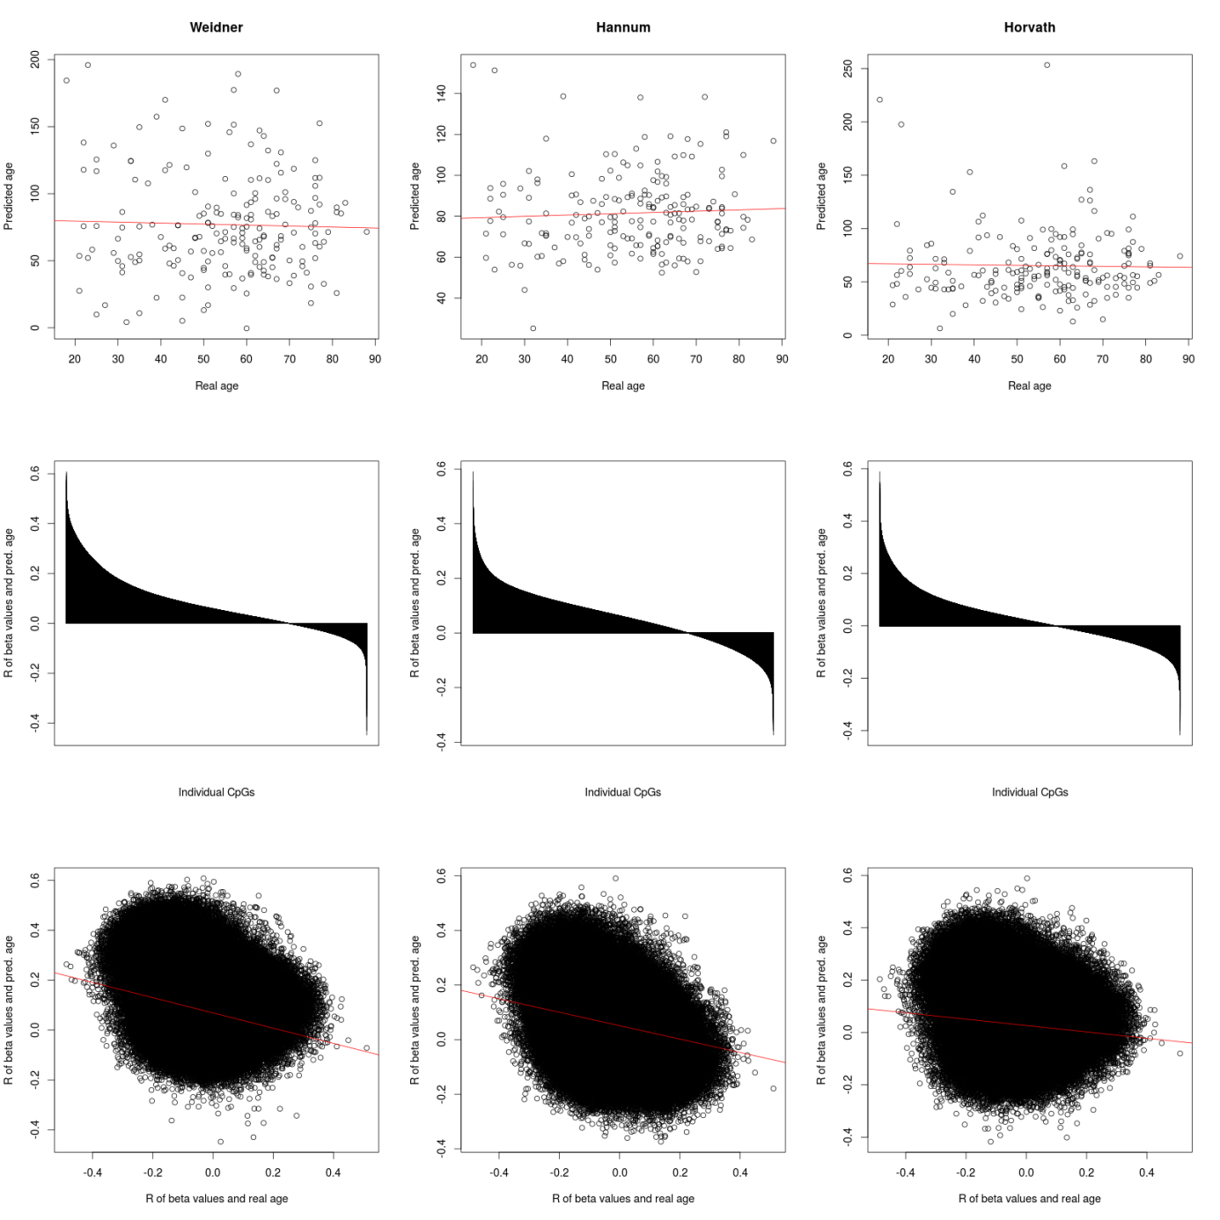
Needs more thinking – why are correlations of predicted and real age anti-correlated?

Slide 2
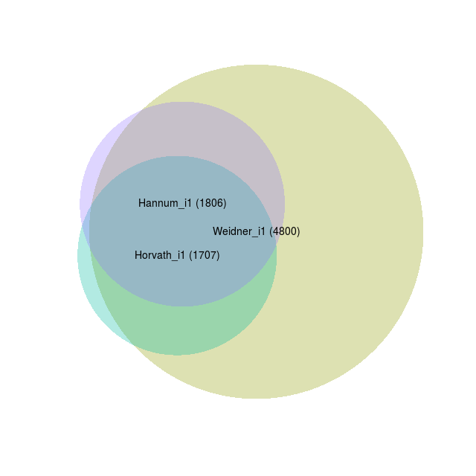

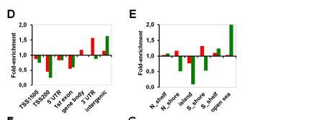
Variance filter >0.05
Correlation > 0.3
Only positive
Variance filter >0.05
Correlation > 0.3
Only negative
Variance filter >0.05
Correlation > 0.3
absolute
Color code for the three different age predictors
postive
Color code for the three different age predictors
negative
Gene Onthology (only absoulte) for each of the three age-predictors
Association with histone code?
Enrichment in chromosomal regions?
Enrichment in TF binding sites
Enrichment in miRNA binding sites???

Slide 3
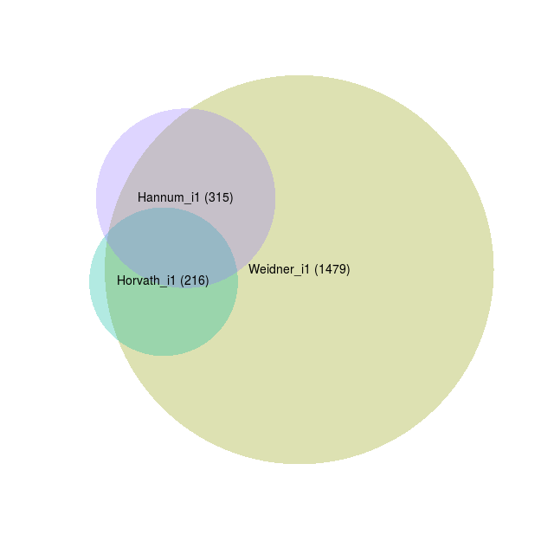
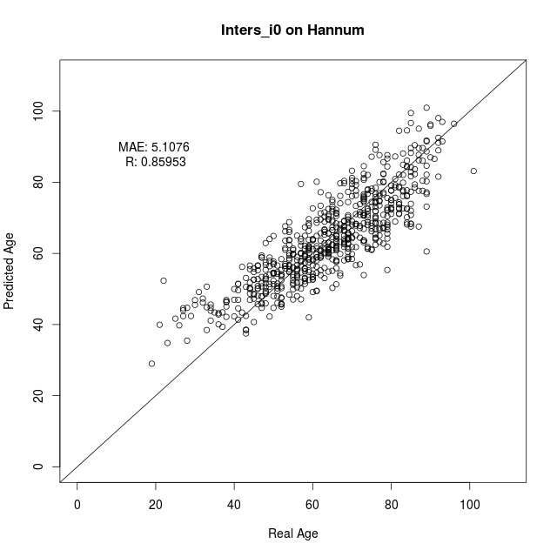
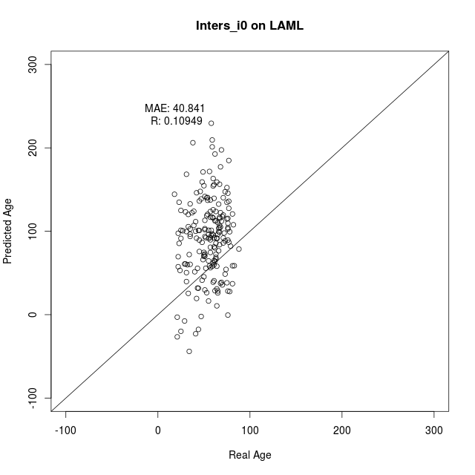
Variance filter >0.05
Correlation > 0.4
Only positive
We should also filter on the variance in Hannum – to exclude Cpgs that do not vary in normal blood.
Furthermore (alternatively) we may consider more stringent filter (e.g. variance > 0.05 and correlation >0.45 – this would give 10 (11) CpGs that are applicable for MassARRAY… with the additional variance filter might be less…
99 CpGs in intersection of the three predictors – and all of them are exclusively positive.
These are used for retraining
… completely distinct from the Weidner 99 CpG model
Same figures as in Lin and Wagner Plos Genetics figure 2
And the survival
Validatio n in other AML datasets:
Karolinska,
AML Halle
AML-AZA
…another on that Tanja downloaded…
?? Test signature on other tumors? Similar to table 1 in Lin and Wagner PLoS Genetics…. If then we ask Qiong
?? Perhaps we can subclone and anlayze DNAm in individual clones?? Furthermore, we can ask Monika who has analyzed individual subclones in normal CD34+ cells…

Slide 4
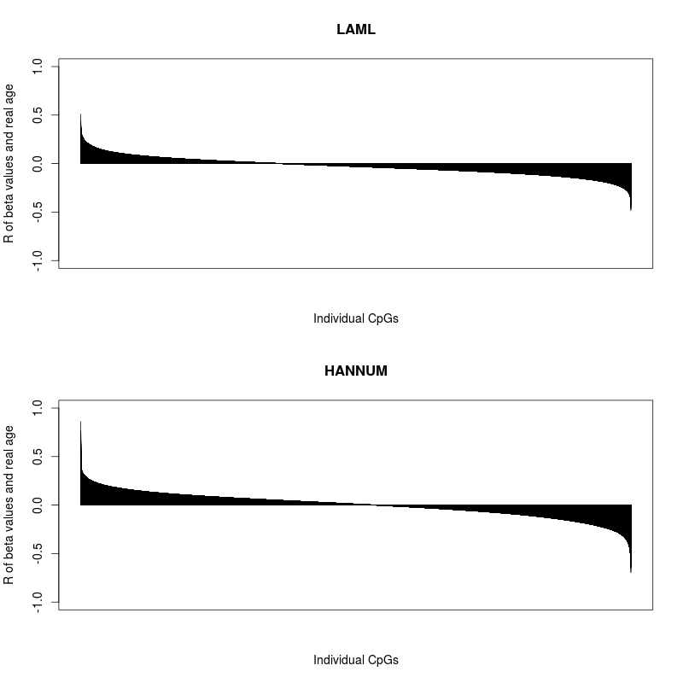
supplement

Slide 5
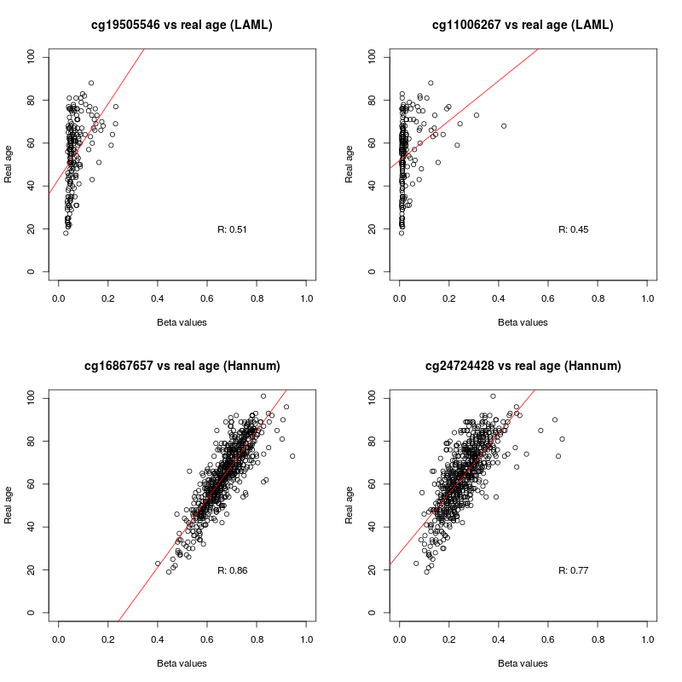
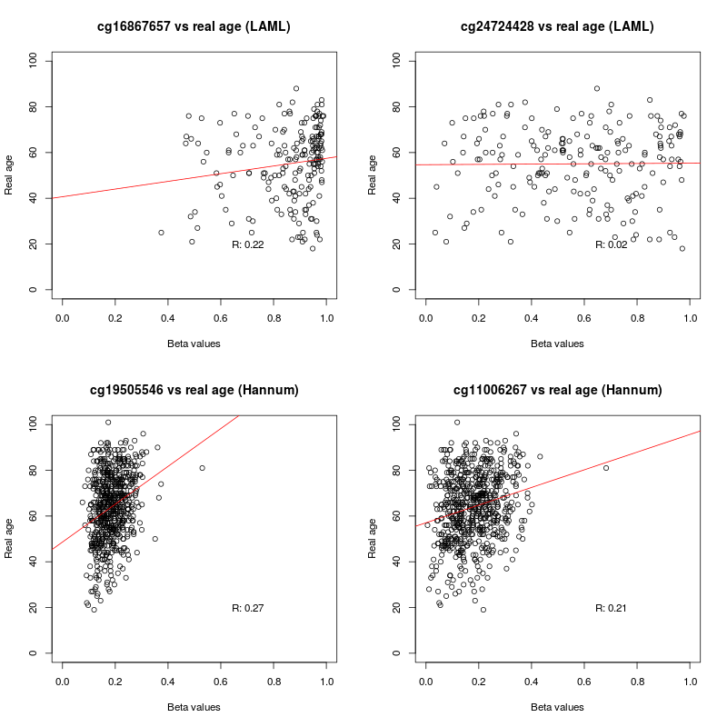
supplement
These are the best performing CpGs in TCGA and Hannum. Take home – there are no good performing individual CpGs in TCGA
Here the above mentioned CpGs are applied to the opposite dataset. They do not perform well on these datasets.

Slide 6
supplement

Slide 7
supplement

